Slide 1

Predicting city status
Students: Lepekhina Anfisa, Udalov Egor, Iufriakova Anastasiia, J4234c

Slide 2
1. Task Statement
A training data from one popular social media is known:
8.5 mil. publications
date is ranging from 01.2019 up to 02.2020 included
Feature | Description
lon, lat | cube coordinates rounded to a 250x250 meter polygon
timestamp | publication timestamp to the nearest hour
likescount | number of “likes”
commentscount | number of comments
symbols_cnt | number of symbols
words_cnt | number of words (only meaningful ones)
hashtags_cnt | number of hashtags
mentions_cnt | number of references to other users
links_cnt | number of links
emoji_cnt | number of emoji
point | cube id
Table. Feature description
2

Slide 3
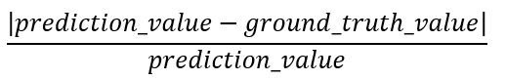
1. Task Statement
Target feature: count – number of publications in cube at a timestamp
Validation data:
only the following features are known: lon, lat, timestamp, point, count
data is aggregated by timestamp and point
date lies between the beginning and the ending of 03.2020
Observation: an aggregation of publications for a cube at some timestamp
Task: to predict the target feature for validation data based on training data (custom score must not exceed 2.6)
Custom score:
3

Slide 4
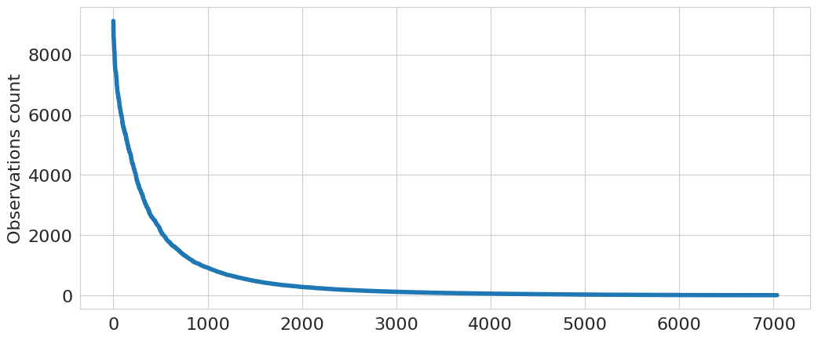
2. Hypothesis
There are two options how to deal with data:
consider data as a set of timeseries
consider data as a tabular
Reason: only 6% of observations are known if to consider that data is known at all timestamps for each cube
H: better score, when considering data as a tabular
Figure. Distribution of the number of observations for cubes (training data). Number of unique timestamps - 9501
4

Slide 5
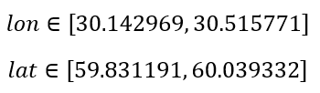
3. Outliers Detection
Two ways of outliers detection were considered:
pinpointing cubes with the coordinates, that do not lie inside defined bounds:
Isolation Forest
As a result, only first approach was used (2.7% size reduction). The usage of Isolation Forest (from 7 to 13% reduction) leads to higher score
5

Slide 6
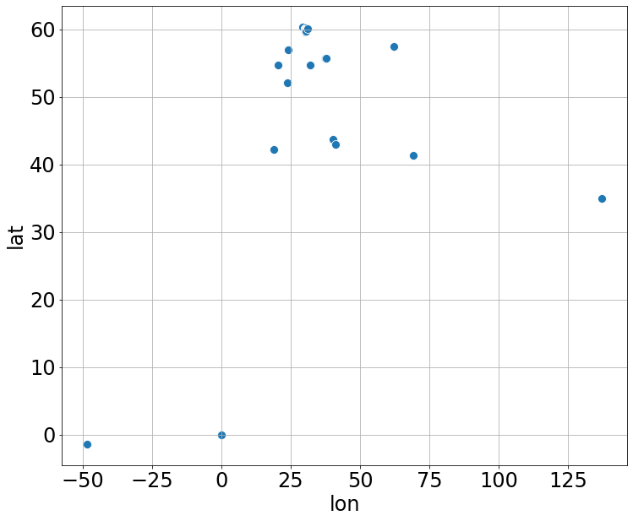
3. Outliers Detection
Figure. Distribution of cubes coordinates
6

Slide 7
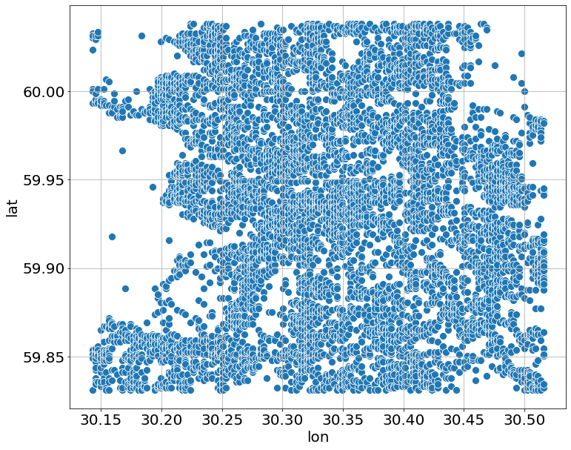
3. Outliers Detection
Figure. Distribution of cubes coordinates within stated bounds
7

Slide 8
4. Data Preprocessing
Steps:
grouping training data by cube and timestamp (count-related features were aggregated by sum)
creating new features instead of timestamp:
hour | day | month | year
is_morning | is_day | is_evening | is_night
weekday | is_weekend | is_holiday | is_working_day
temperature
Table. List of new features
filling in empty data for count-related features in evaluation and test data using training data (via mean value and grouping by cube, hour, month and weekday)
8

Slide 9
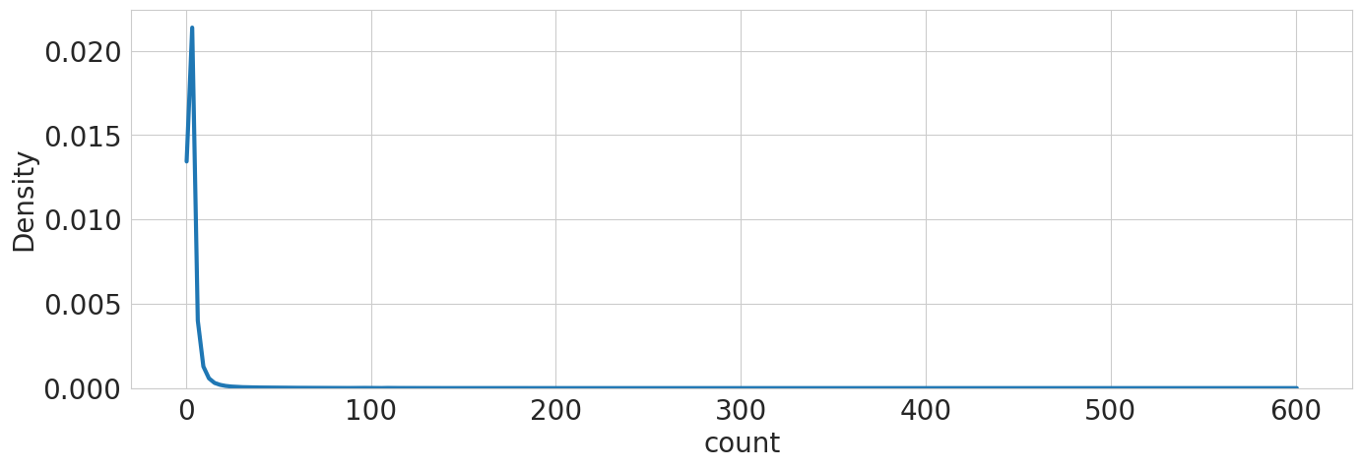
5. Model & Objective Function
Model considered: xgboost regressor - light model with high performance
Objective Function: tweedie - target feature has similar distribution
Figure. Target feature distribution
9

Slide 10
6. Feature Selection
Techniques considered:
Correlation
Greedy Search
Permutation Importance
Only the last technique showed better results, so it was considered later
Two sets of features were considered:
- all features
without count-related features
9

Slide 11
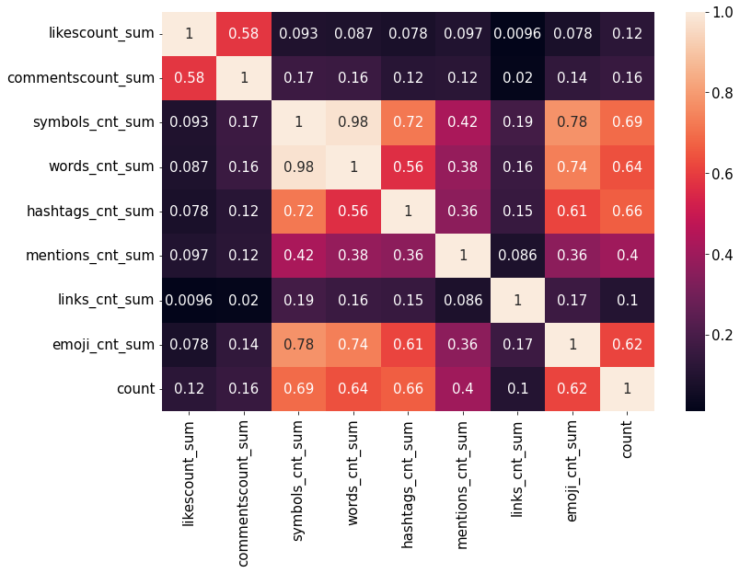
5. Feature Selection
Figure. Spearman correlation (count-related features and target feature)
10

Slide 12
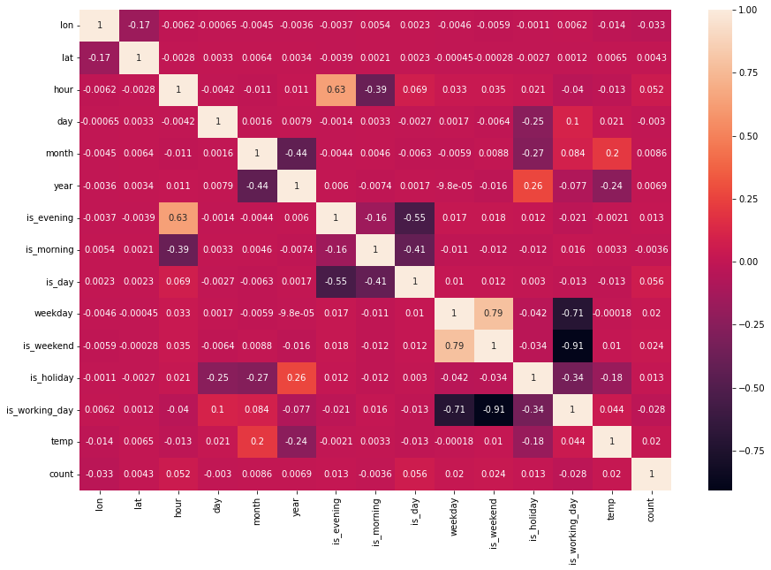
5. Feature Selection
Figure. Spearman correlation (without count-related features)
10

Slide 13
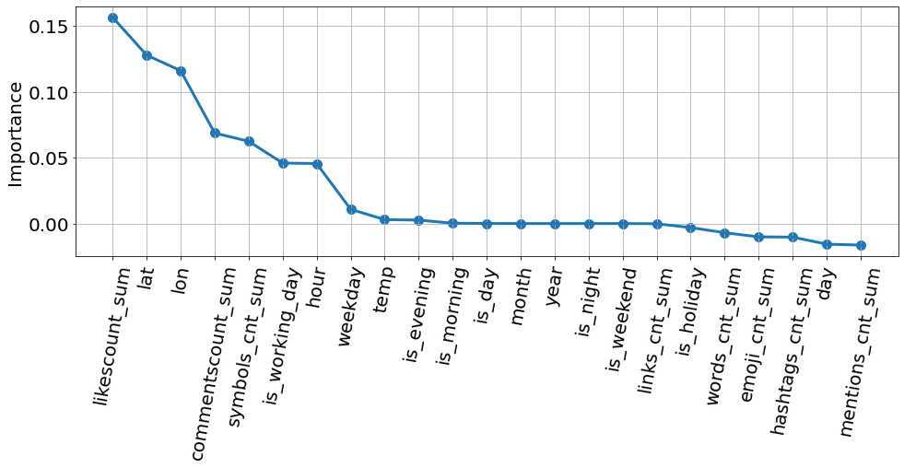
5. Feature Selection
Case 1: all features
Figure. Importance values (all features)
10

Slide 14
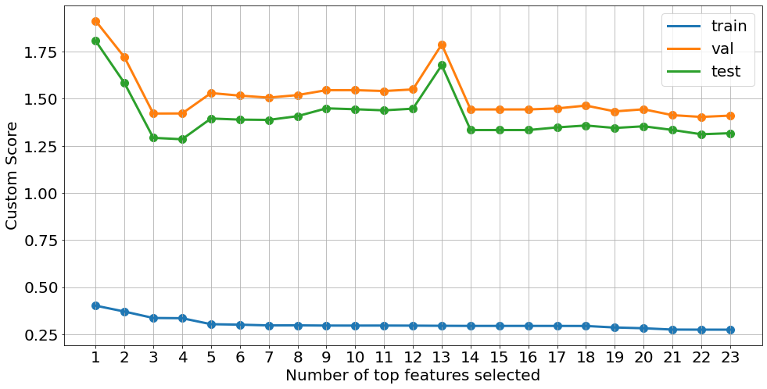
5. Feature Selection
Figure. Custom score dependency on number of top features selected (all features)
9

Slide 15
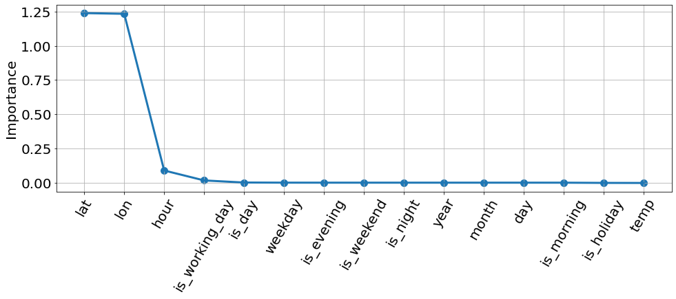
5. Feature Selection
Case 2: without count-related features
Figure. Importance values (without count-related features)
11

Slide 16
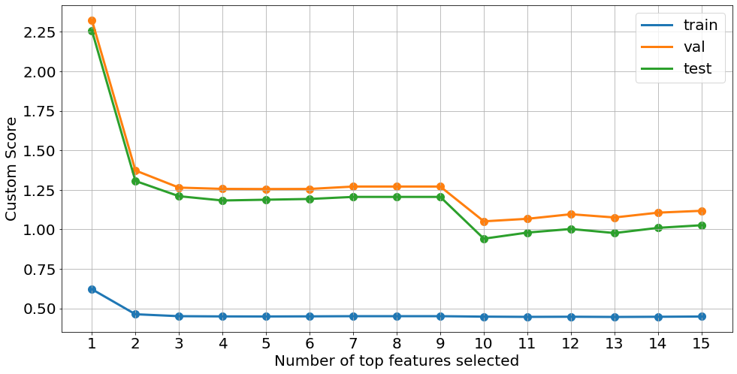
5. Feature Selection
Figure. Custom score dependency on number of top features selected (without count-related features)
12

Slide 17
6. Hyperparameter Optimization
Techniques considered:
Grid Search
Optuna
Case | Optimization technique | learning rate | max depth | number of estimators | lambda | alpha | colsample bytree | subsample
1 | Grid Search | 1 | 10 | 800 | 1 | 1 | 1 | 1
2 | Grid Search | 0.215 | 8 | 800 | 0.1 | 10 | 1 | 1
3 | Optuna | 0.129 | 7 | 1000 | 0.464 | 10 | 1 | 0.6
Table. Best sets of parameters found after optimization
12

Slide 18
7. Best Results
Case | Model | Optimization technique | Custom Score | Score (val) | Score (test) | MAPE
 |  |  | Train | Val | Test | Train | Val | Test
- | Dummy Regressor | - | 0.751 | 3.223 | 3.152 | 0.948 | 0.694 | 0.688
- | xgboost | - | 0.445 | 1.075 | 0.976 | 0.553 | 0.434 | 0.419
1 | xgboost | Grid Search | 0.336 | 0.861 | 0.796 | 0.388 | 0.413 | 0.396
2 | xgboost | Grid Search | 0.352 | 0.870 | 0.805 | 0.408 | 0.408 | 0.396
3 | xgboost | Optuna | 0.373 | 0.860 | 0.791 | 0.438 | 0.406 | 0.389
Table. Results
12

Slide 19
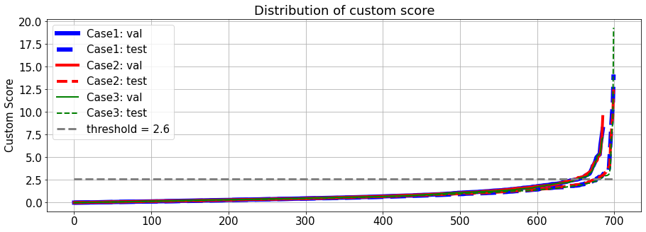
7. Best results
Figure. Distribution of custom score
15

Slide 20
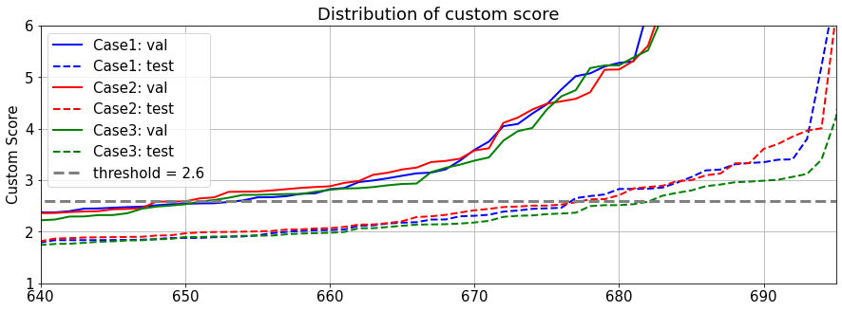
7. Best results
Figure. Distribution of custom score near intersection points
15

Slide 21
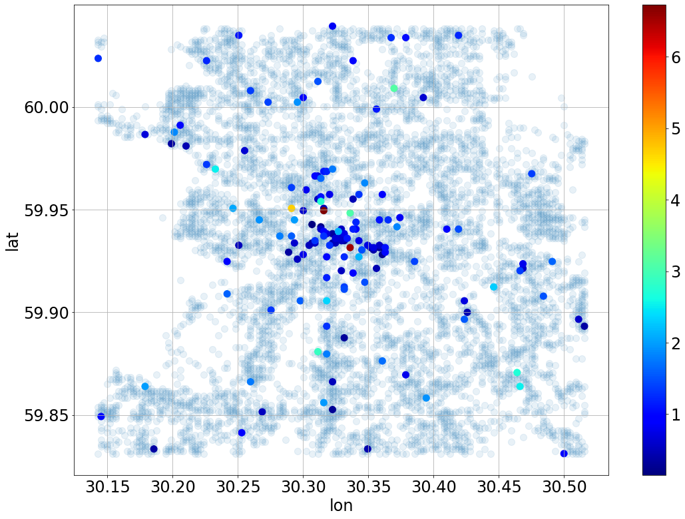
7. Best results (case 3)
Figure. Distribution of mean score on test data (grouped by cube)
14

Slide 22
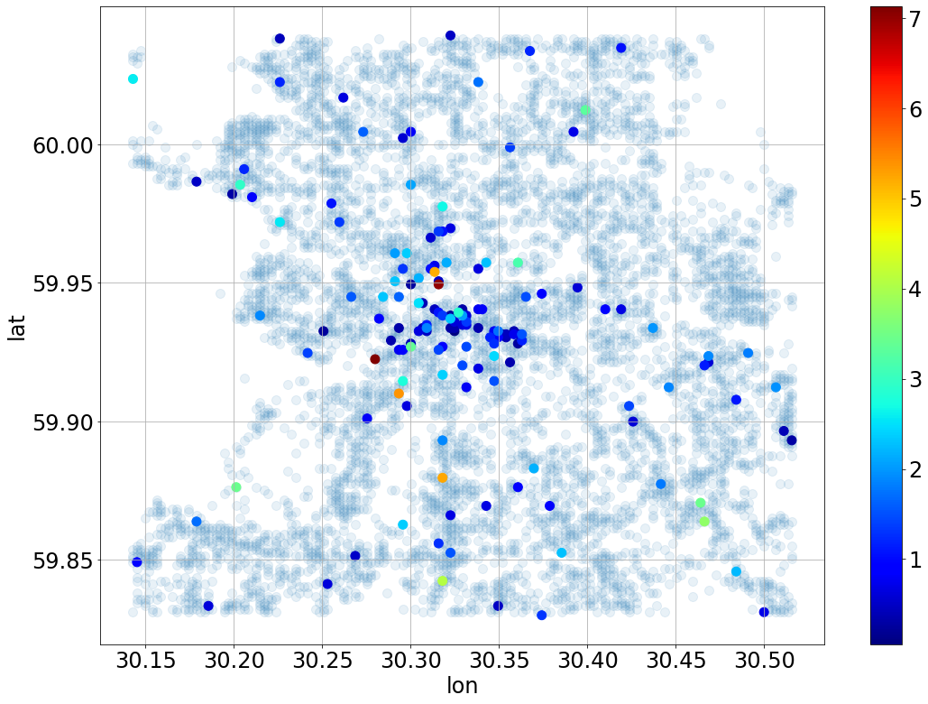
7. Best results (case 3)
Figure. Distribution of score on validation data (grouped by cube)
15

Slide 23
Conclusions
Best model showed results within stated criteria for custom score
Ideas to improve results:
Count-related features can improve results (it is clearly seen on training data), but one must use more elaborate techniques to predict missing data for validation and test datasets (e.g. to train a separate ML model for each feature)
Use other Feature Selection techniques: Simulated Annealing, Genetic Algorithm, Particle swarm optimization
Other high-performant models can be considered (CatBoost, LightGBM) – result might also improve
12

Slide 24
THANK YOU FOR YOUR TIME!

